Slide 1

WELCOME
TO

Slide 2
Fundamentals of DATA analytics WITH TABLEAU
PROJECT TITLE
INDIA’S AGRICULTURED CROP PRODUCTION ANLYSIS (1997 – 2021)

Slide 3
TEAM PROFILE
NM TEAM ID NM2023TMID15878
DEPARTMENT – IIIrd B.Sc. Mathematics.,
TEAM LEADER
NATHIYA.V -
027DB8B46FAFFE182934239FDBC870EE
TEAM MEMBERS
ISWARYA.M -
1911ED4E268ED59B2E3476DB17680C96
LOGESHWARI.N -
E4D4175D557C324A588460D1143EB521
KAMATCHI.V -
ED3C0566A9A1C5DB12D40E0FCF0EBCF1

Slide 4

Project Title
The Tableau India’s Agricultured Crop Production Analysis(1997-2021)
This is a group project. We have include four members on this project. Namely,
I am the TEAM LEAD : NATHIYA V, TEAM PERSONS:ISWARYA M ,LOGESHWARI N ,KAMATCHI V.
Team NM ID : NM2023TMID15878
IIIrd B.Sc.Mathematics
Under The Guidance of
S.SATHISH,M.Sc.,M.Phil.,
GUEST LECTURER PG & RESEARCH DEPARTMENT OF MATHEMATICS,
GOVERNMENT THIRUMAGAL MILLS COLLEGE,
GUDIYATTAM-632602.

Slide 5
INTRODUCTION
1. OVERVIEW
According to India is a global agricultural powerhouse. It is the world's largest producer of milk, pulses, and spices, and has the world's largest cattle herd (buffaloes), as well as the largest area under wheat, rice and cotton. It is the second largest producer of rice, wheat, cotton, sugarcane, farmed fish, sheep & goat meat, fruit, vegetables and tea. While agriculture’s share in India’s economy has progressively declined to less than 15% due to the high growth rates of the industrial and services sectors, the sector’s importance in India’s economic and social fabric goes well beyond this indicator.

Slide 6
2.PURPOSE
Let us analyze the Indian Agriculture crop production for the data collected from 1997 to 2022.
Let us ask interesting questions on existing data, get production and area statistics and understand more on the Indian Agriculture history for crop production.

Slide 7
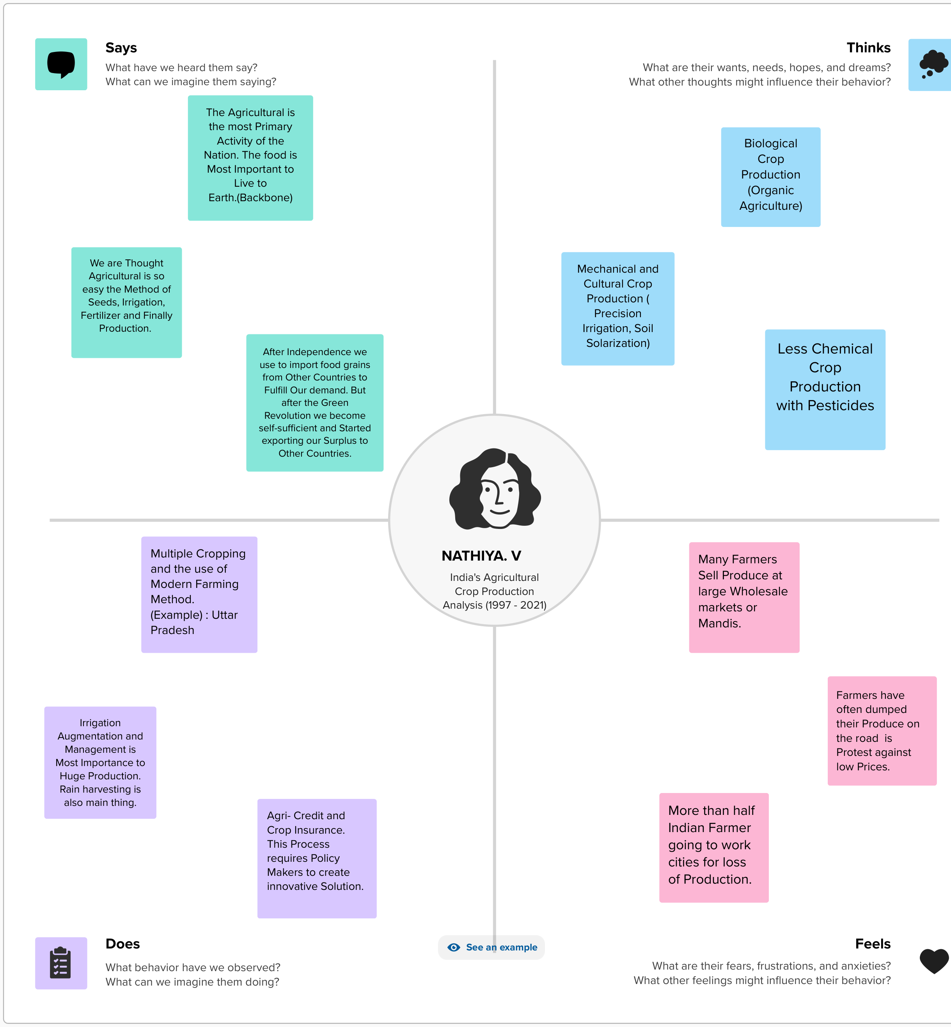
PROBLEM DEFINING & DESIGN THINKING
2.1 Empathy Map

Slide 8
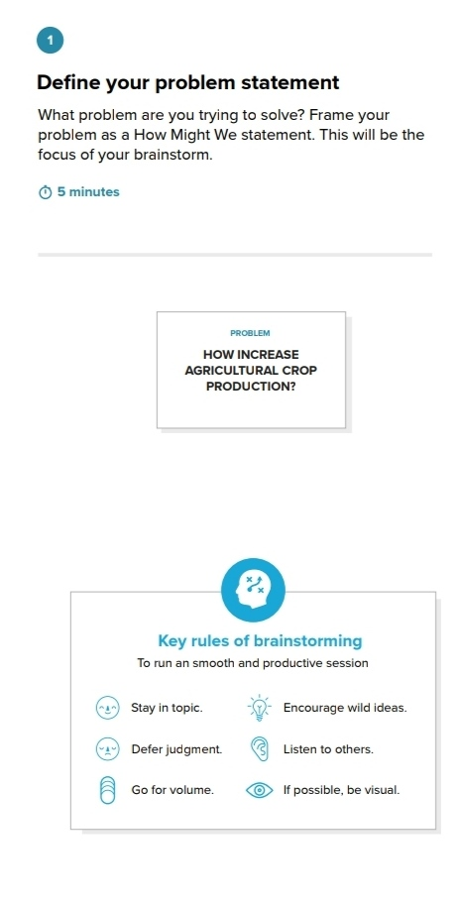
2.2 Ideation & Brainstorming Map

Slide 9
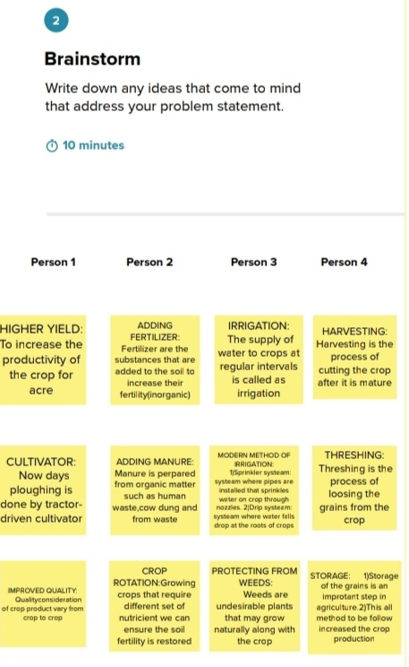

Slide 10
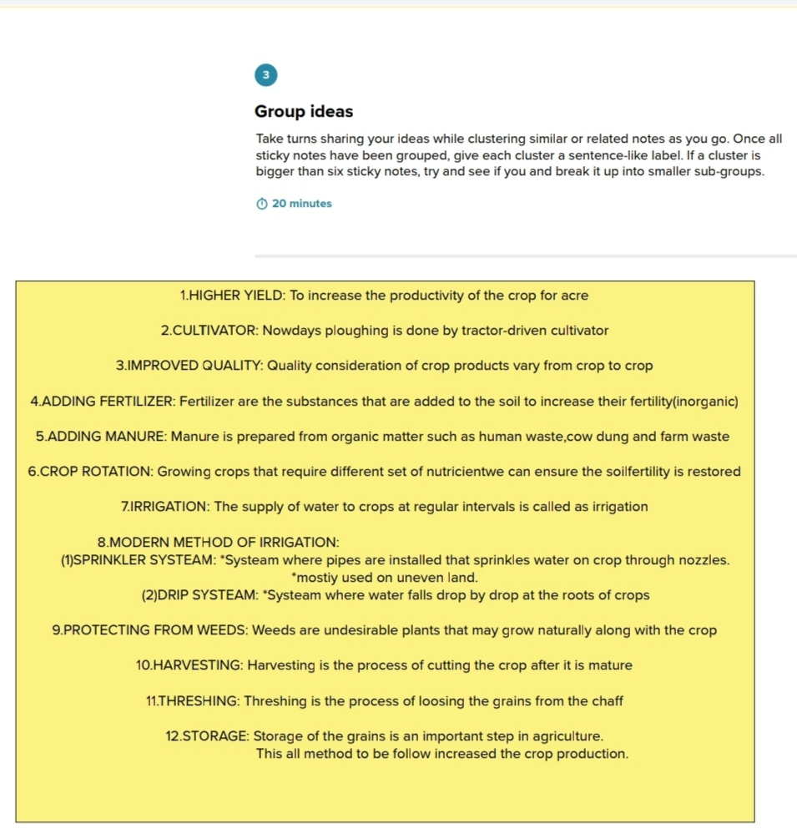

Slide 11
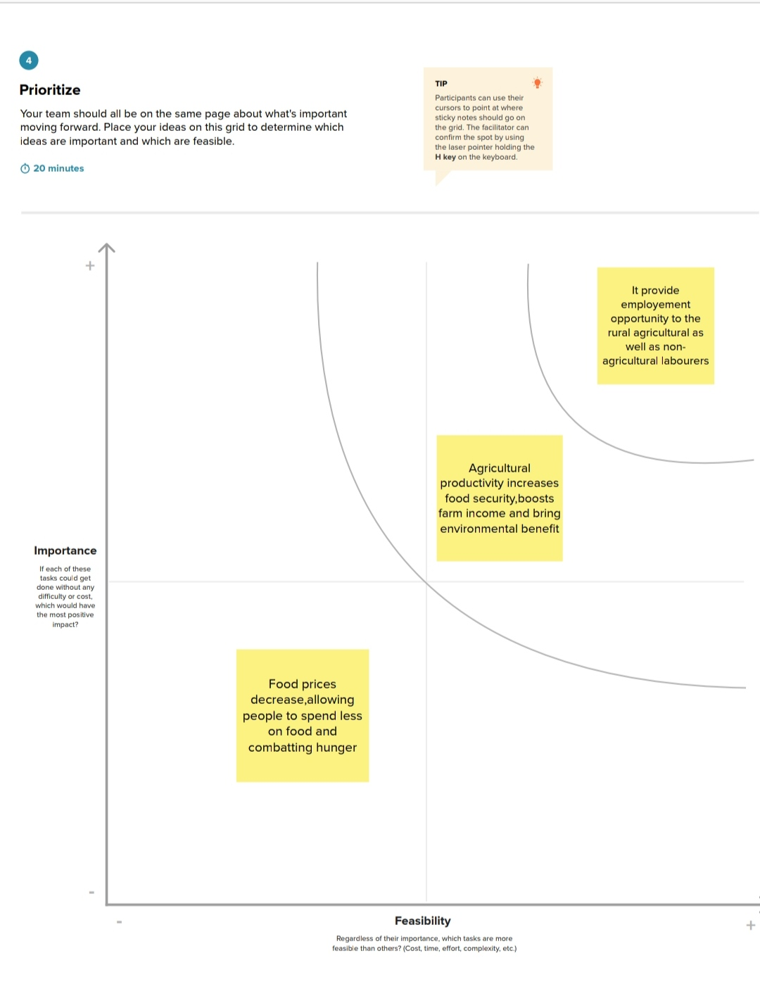

Slide 12
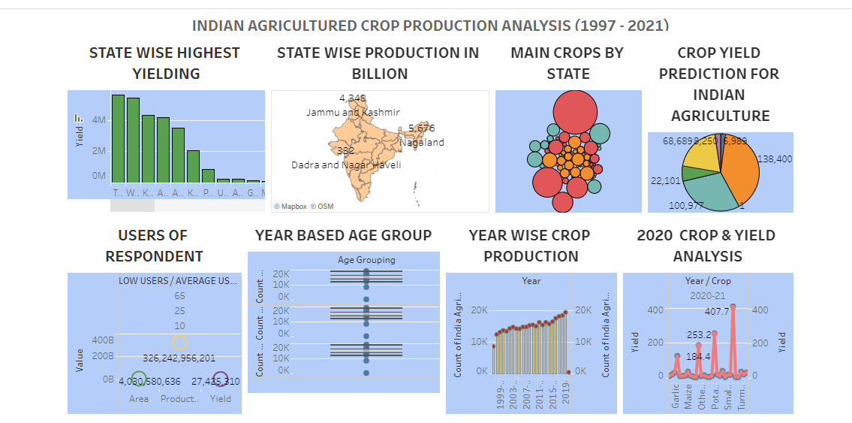
3.result : Final findings (output) of the project

Slide 13
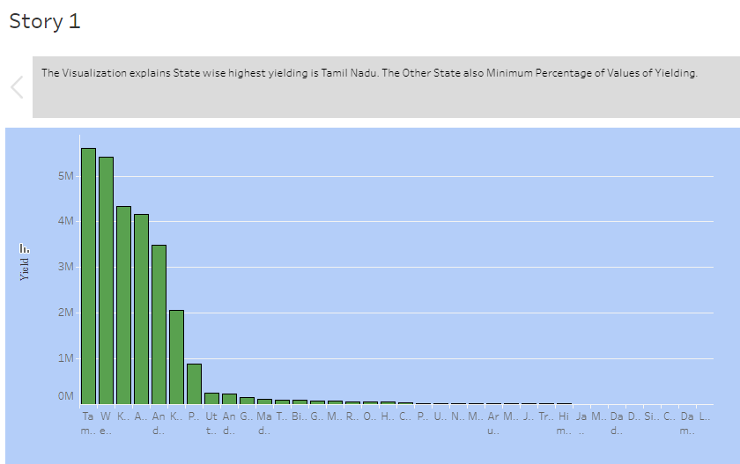
Story
Visualization 1:
INDIA’S AGRICULTURED CROP PRODUCTION ANALYSIS (1997-2021)

Slide 14
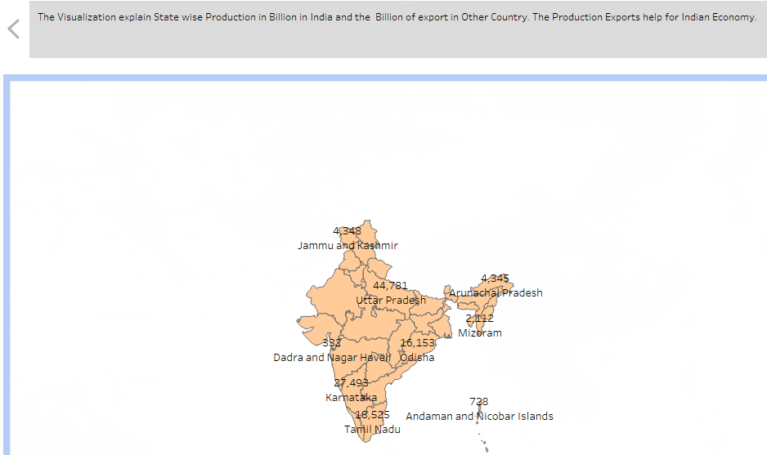
Story
Visualization 2:
INDIA’S AGRICULTURED CROP PRODUCTION ANALYSIS (1997-2021)

Slide 15
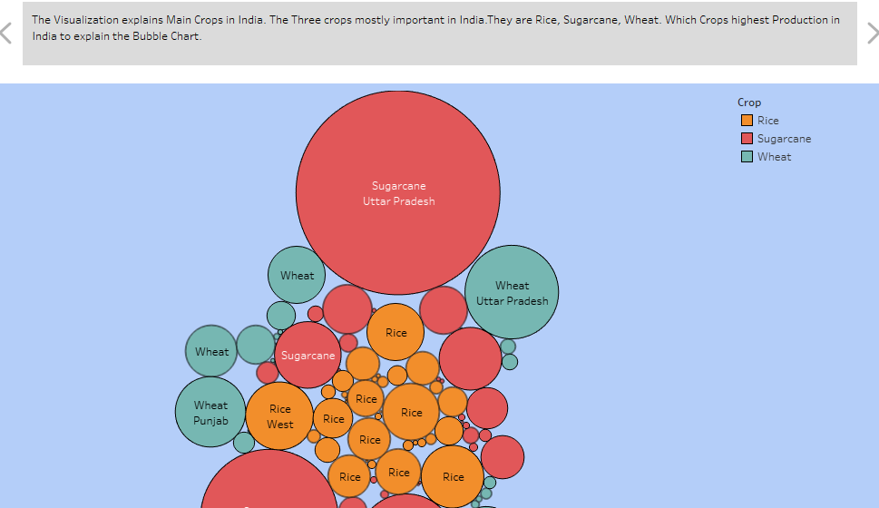
Story
Visualization 3:
INDIA’S AGRICULTURED CROP PRODUCTION ANALYSIS (1997-2021)

Slide 16
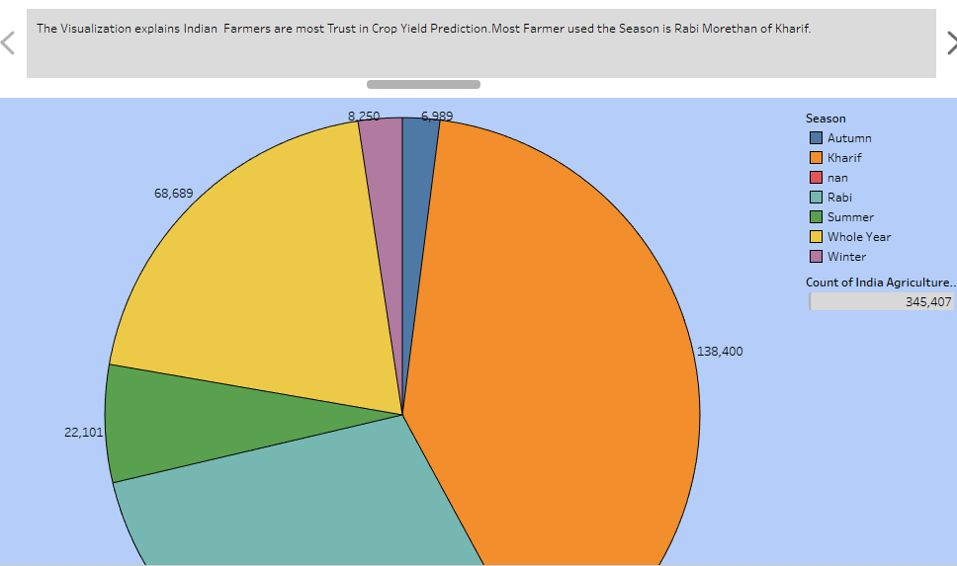
Story
Visualization 4:
INDIA’S AGRICULTURED CROP PRODUCTION ANALYSIS (1997-2021)

Slide 17
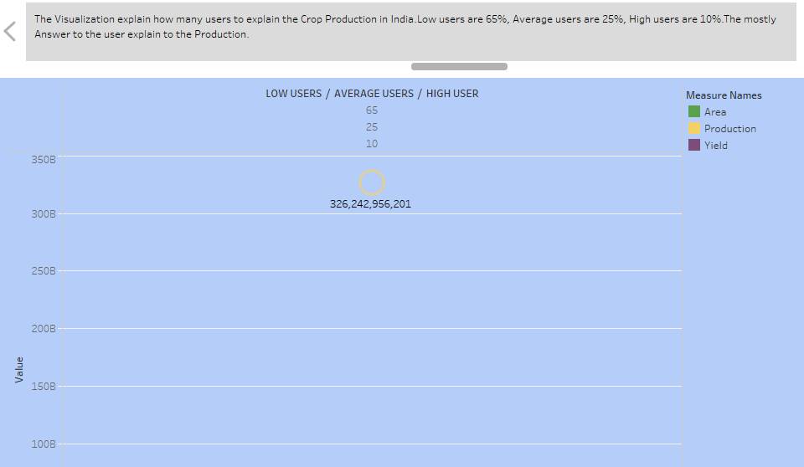
Story
Visualization 5:
INDIA’S AGRICULTURED CROP PRODUCTION ANALYSIS (1997-2021)

Slide 18
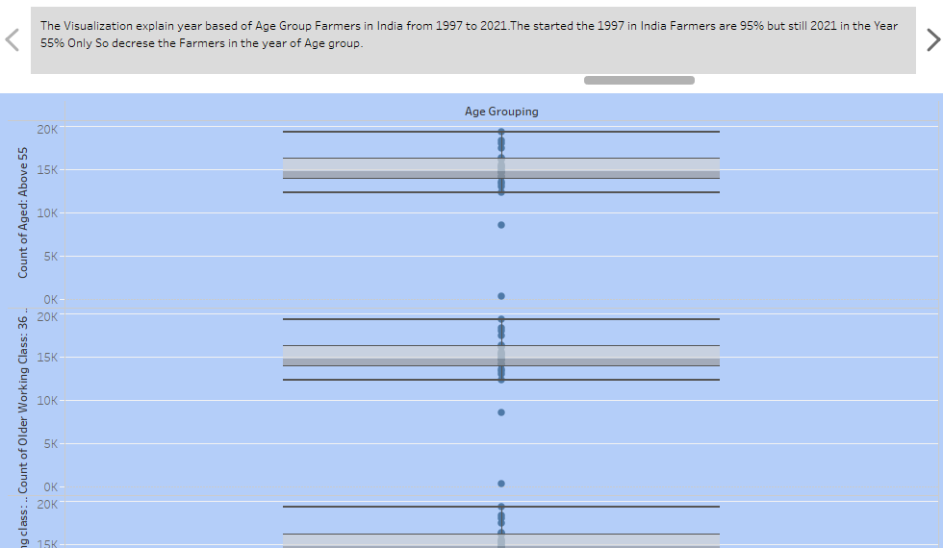
Story
Visualization 6:
INDIA’S AGRICULTURED CROP PRODUCTION ANALYSIS (1997-2021)

Slide 19
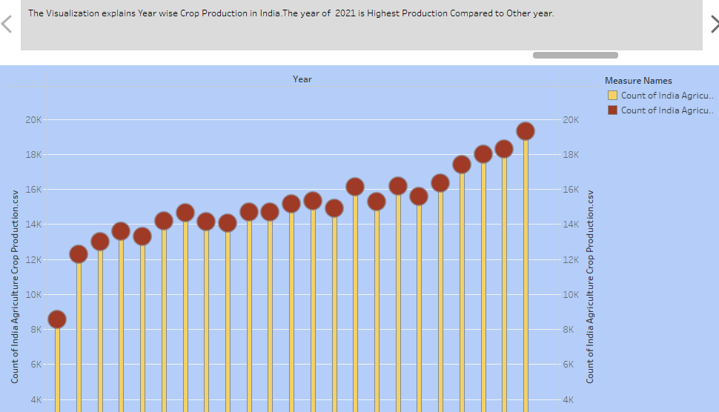
Story
Visualization 7:
INDIA’S AGRICULTURED CROP PRODUCTION ANALYSIS (1997-2021)

Slide 20
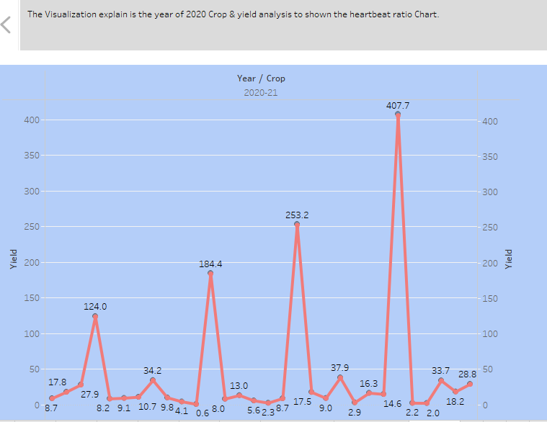
Story
Visualization 8:
INDIA’S AGRICULTURED CROP PRODUCTION ANALYSIS (1997-2021)

Slide 21
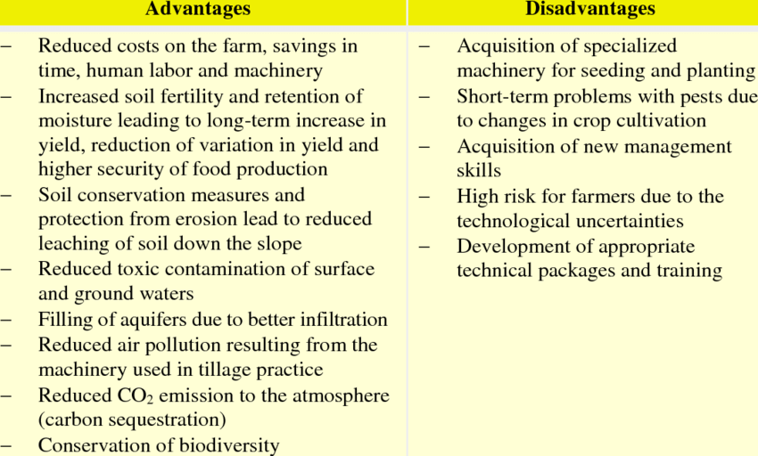
4.ADVANTAGES & DISADVANTAGES :

Slide 22
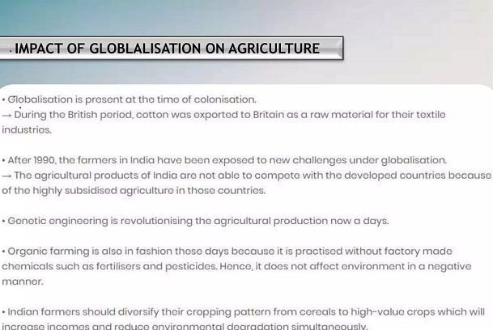

Slide 23
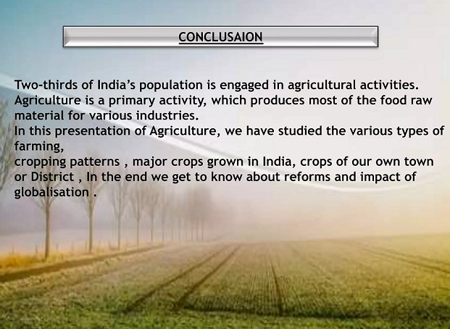

Slide 24
DASHBOARD LINK:
https://public.tableau.com/views/NMDemo_16962153109240/Dashboard2?:language=en-US&publish=yes&:display_count=n&:origin=viz_share_link
STORY LINK:
https://public.tableau.com/views/NMSTORY_16963857359530/Story1?:language=en-US&publish=yes&:display_count=n&:origin=viz_share_link

Slide 25


